Slide 1

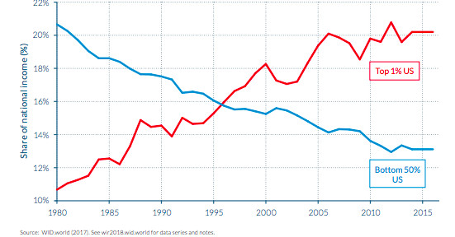
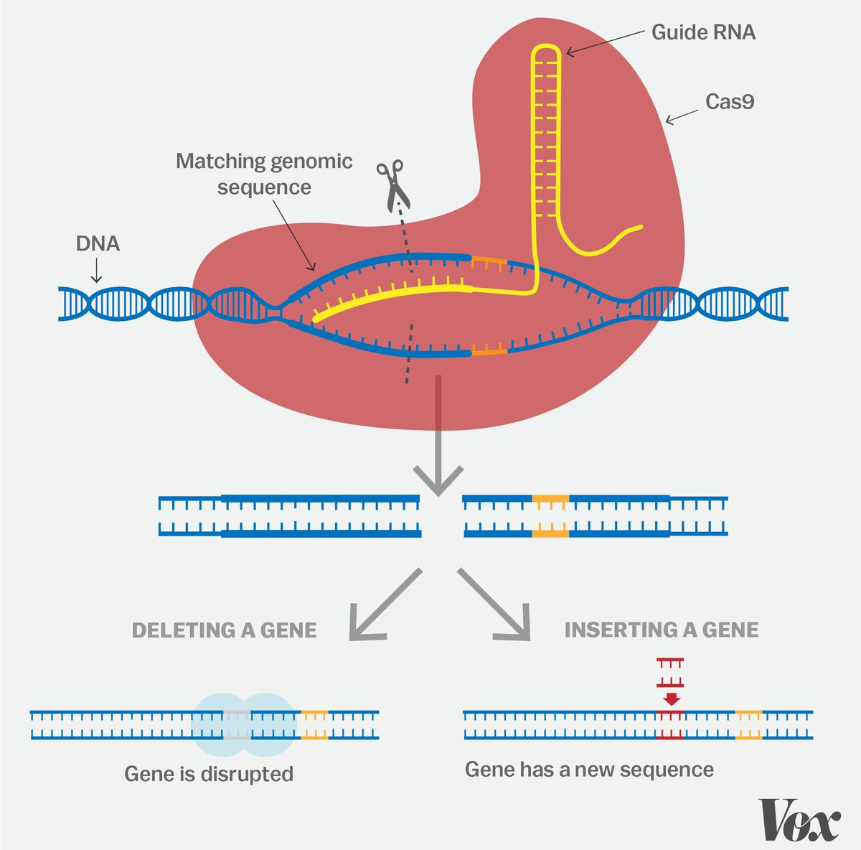
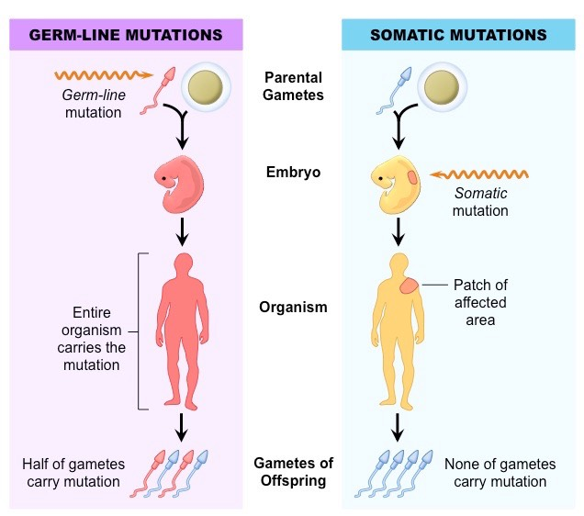
Ethical Issues Surrounding Somatic and Germline Genetic Editing
Mia Han and Parker Valdez
Consequences of Gene Editing
What is Gene Editing?
Widens socioeconomic gap
Wealthy parents can give their kids a large advantage, boosting traits such as intelligence of athletics that will promote wealth.
Conversely, poorer families will be at a disadvantage, as wealthier people can artificially boost traits past human limits
May cause sexism and discrimination
With the introduction of the ability to choose childrens’ sex, one sex may dominate the other.
“Imperfect” people could be outcasted and frowned upon,, and society can discriminate against those whose parents didn’t modify them.
Gene editing is the deliberate alteration of a selected DNA sequence in a living cell
Researchers create a piece of RNA with a “guide” sequence that binds to a specific target site on the DNA and cuts the DNA at the targeted location
The cell’s own DNA repair machinery will add or delete pieces of genetic material, or replace an existing segment with a customized DNA sequence
Unexpected consequences
Altering genomes have a high chance of creating unintentional mutations that may lead to harmful and irreversible consequences.
Ex: p53, a tumor suppressor, may be activated at CRISPR edited sites. Since it is activated, it will no longer suppress the tumor gene.
Treatment of Genetic Diseases
Early research into somatic genetic editing reveals that it has the potential to treat genetic diseases
However, the negative consequences far outweigh the potential positive outcomes
Gene editing as a whole must be at least regulated to justify its use
Weapon of mass destruction
Bio-terrorists can potentially weaponize this technology
Using CRISPR, violent genetically modified plagues could be used to wipe out humans, livestock, or agriculture
Somatic vs Germline Gene Editing
Somatic gene editing occurs in a single organism and cannot be inherited
Germline gene editing occurs in gametes and can be passed onto offspring. Every cell in the entire organism is affected.

